Slide 1
Smart Watch Progress Report 11/7
Derek Tan, Julian Nguyen, Eddie Ryan

Slide 2
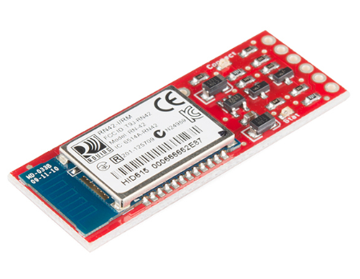
Bluetooth Research
Obtained SparkFun header board for RN-42 Bluetooth module
Connected to MSP430 via UART
Terminal program is needed to connect to computer
Will do an echo test to ensure proper connection
RX and TX pins connected together
Set the baud rate and COM port from terminal
If LED turns on then, the module is connected successfully
Type into terminal to see if data is being transmitted to Bluetooth module

Slide 3
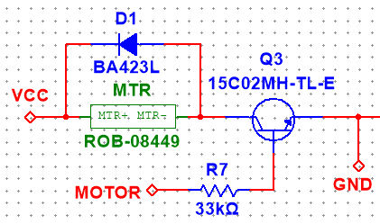
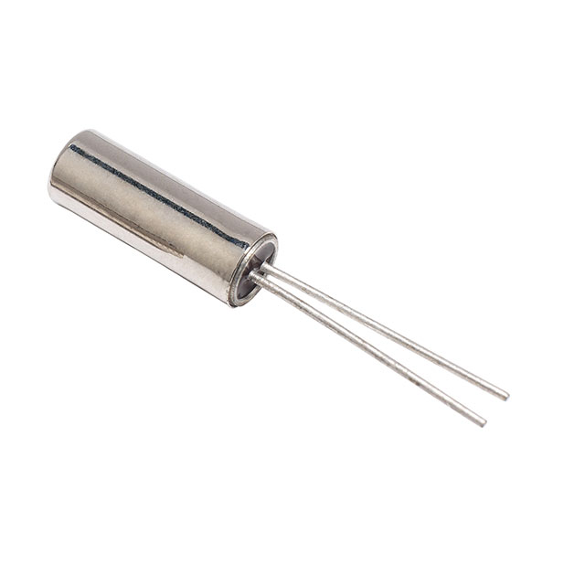
Schematic/Board Changes
Vibration motor driver with flyback diode
Watch crystal on XIN/XOUT for accurate timekeeping

Slide 4
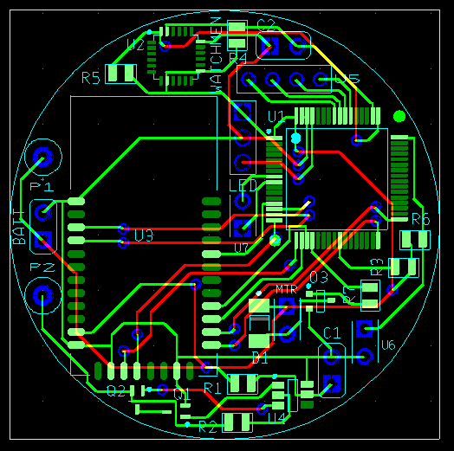
Planned Board Testing
3W mounting for power module and IMU/LED subsystem
Test board connections, battery charging, and housing
Configure gyro/accel for board orientation

